Slide 1
Sample Presentation from The Uni Tutor www.theunitutor.com
Company Analysis of Club Med

Slide 2
Agenda
Company Profile
Company Analysis
International Strategy
Advertising Campaign
ABCD Paradigm
Important Aspects
Closed or Open?
Ad Campaigns
Distribution

Slide 3
COMPANY BACKGROUND
Worldwide leader in all-inclusive holidays
140 resort villages in Mediterranean, snow, inland, and tropical locations in 40 countries
Operates tours and 2 cruise liners:
Club Med 1 (Caribbean sailing)
Club Med 2 (Pacific sailing)
Marketed by over 1500 travel agencies, through its direct and indirect distribution networks
Company Profile
Symptoms
Company Analysis
International Strategy
Advertising Campaign
ABCD Paradigm
Reflections

Slide 4
MISSION STATEMENT
“Club Med is a refined, generous, and a la carte holiday that will meet all your expectations”
~Henri Giscard D’Estang~
President
Company Profile
Symptoms
Company Analysis
International Strategy
Advertising Campaign
ABCD Paradigm
Reflections

Slide 5
HISTORY
1950: Founded by a group of travelers, headed by Gerald Blitz
1954: From nonprofit sports organization to hotel business
1985: Public Traded Company on Paris Stock Exchange
Company Profile
Symptoms
Company Analysis
International Strategy
Advertising Campaign
ABCD Paradigm
Reflections
Notes:
Started in 1950 by a group of friends, Club Med has since then gone from a nonprofit sports organization to the ninth-largest hotel company in the world. As the size of the association grew, managing it also became more and more complex. It was in 1954, newly appointed managing director, Gilbert Trigano, saw a commercial opportunity in the concept of turning the association into a business. By 1985, the Club had become a publicly owned company on the Paris Stock Exchange and opened100 resort villages that could host up to 800,000 vacationers.

Slide 6
PRODUCT
5 styles of holidays
1. Experience the exceptional
2. Have a taste of everything
3. Discover new horizons
4. Stretch yourself to the limit
5. Feel renewed
Club Med additional activities: cruises, getaways, spas, wellness programs, sports, and retail therapy at Club Med boutiques
For children and teens: Mini Club Med and Junior's Club Med
Company Profile
Symptoms
Company Analysis
International Strategy
Advertising Campaign
ABCD Paradigm
Reflections
Notes:
All Club Med villages are similar in their setup regardless of what part of the world they are in. The resort sites are carefully chosen by taking into consideration the natural beauty (i.e., scenic views, beachfront, woodland, no swampland, etc.), good weather, and recreational potential. Each resort has approximately 40 acres to accommodate all the planned activities: windsurfing, sailing, basketball, volleyball, tennis, etc. The resorts’ secluded atmosphere is further exemplified by the lack of daily “conveniences” such as: TV, clocks, radios, even writing paper. This is done to separate individuals from civilization so they can relax as much as possible.

Slide 7
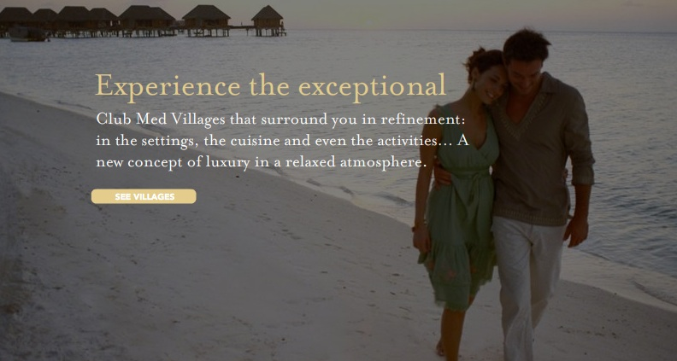
PRODUCT
Company Profile
Symptoms
Company Analysis
International Strategy
Advertising Campaign
ABCD Paradigm
Reflections
Notes:
Refined hotels of the company.
5stars plus with gourmet cuisine and luxury setting

Slide 8
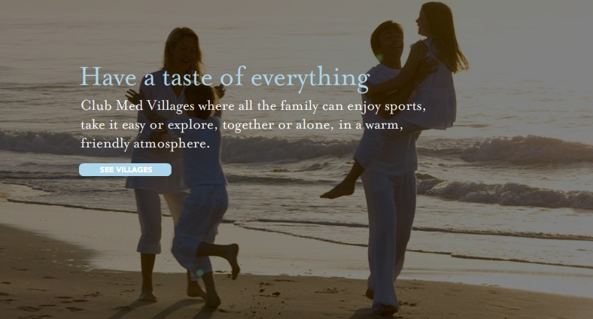
PRODUCT
Company Profile
Symptoms
Company Analysis
International Strategy
Advertising Campaign
ABCD Paradigm
Reflections
Notes:
Family oriented with sports and activities

Slide 9
PRODUCT
Company Profile
Symptoms
Company Analysis
International Strategy
Advertising Campaign
ABCD Paradigm
Reflections
Notes:
Encourages discovery in a multicultural atmosphere

Slide 10
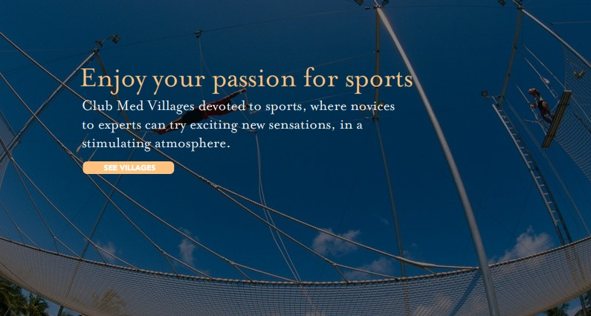
PRODUCT
Company Profile
Symptoms
Company Analysis
International Strategy
Advertising Campaign
ABCD Paradigm
Reflections
Notes:
Novices to experts can try exciting new sensations

Slide 11
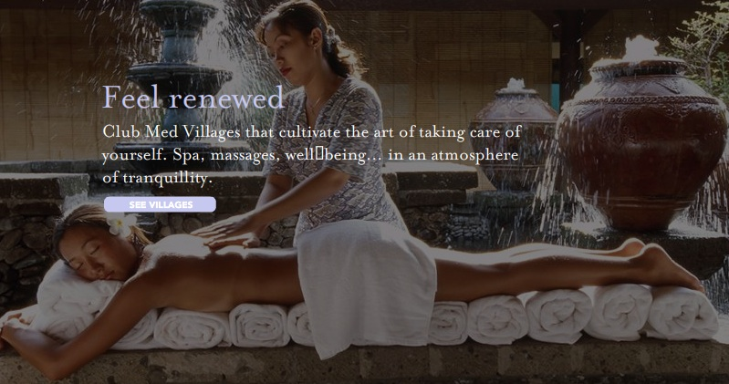
PRODUCT
Company Profile
Symptoms
Company Analysis
International Strategy
Advertising Campaign
ABCD Paradigm
Reflections
Notes:
Spa, massages, and tranquility atmosphere

Slide 12
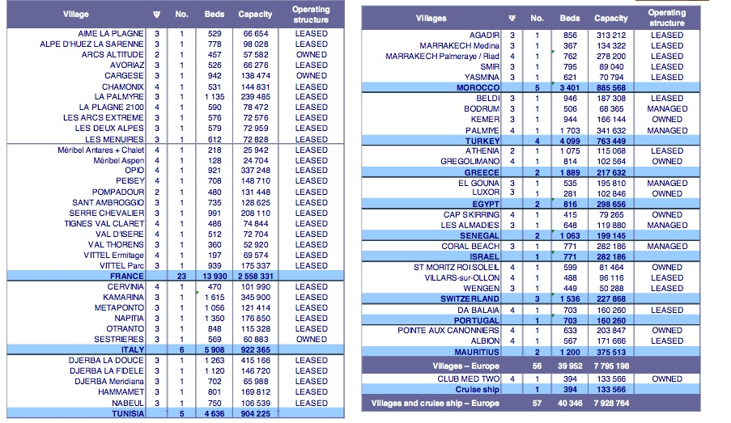
PRODUCT
Company Profile
Symptoms
Company Analysis
International Strategy
Advertising Campaign
ABCD Paradigm
Reflections
Notes:
As mentioned before, Club Med has resort villages in Mediterranean, snow, inland, and tropical locations in 40 countries
Europe 57 villages, capacity of over 7 million.

Slide 13
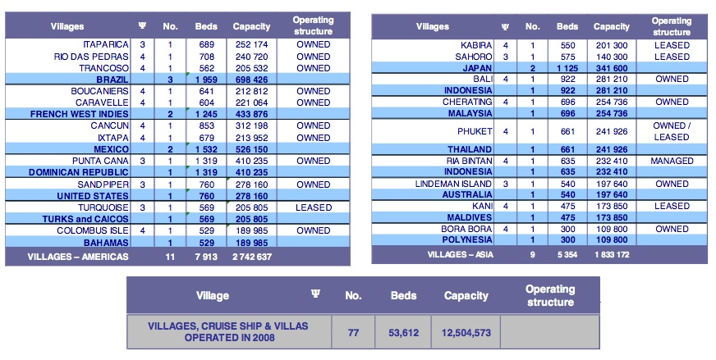
PRODUCT
Company Profile
Symptoms
Company Analysis
International Strategy
Advertising Campaign
ABCD Paradigm
Reflections
Notes:
America 11 villages .capacity of over 2 million
Asia 9 villages capcity of about 2 million

Slide 14
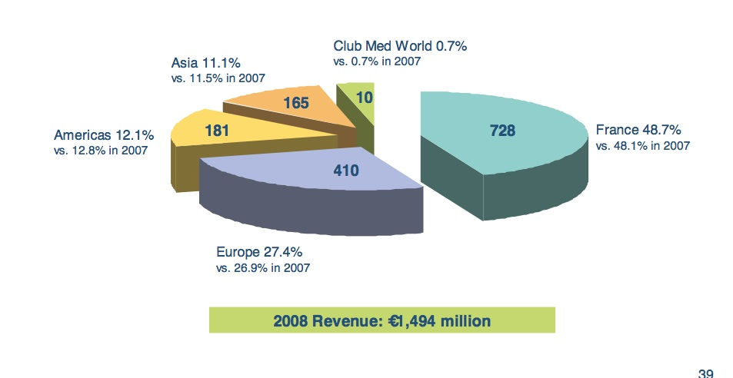
Revenue by Region
Company Profile
Symptoms
Company Analysis
International Strategy
Advertising Campaign
ABCD Paradigm
Reflections
Notes:
Clientele: 1/3 French. Rest from NA and Japan

Slide 15
PRICE
1.Departure City
2.Destination City
3.Hotel
4.Season
Low season: “50% OFF SECOND PERSON”
Valentine’s Day and Presidential Day
“3 DAYS FREE”
Company Profile
Symptoms
Company Analysis
International Strategy
Advertising Campaign
ABCD Paradigm
Reflections
Notes:
Basically the price of s package depends on 4 factors.

Slide 16
PRICE
Turks and Caicos, Caribbean
2 persons, 7 days, tx in.
March 2009, from NYC: $ 3755,40
March 2009, from Paris: € 4 995,00
July 2009, from NYC: $ 3426,40
July 2009, from Paris:€ 4 513,00
Christmas 2009, from NYC: $ 5917,40
Christmas 2009, from Paris: € 6 635,00
Company Profile
Symptoms
Company Analysis
International Strategy
Advertising Campaign
ABCD Paradigm
Reflections

Slide 17
PRICE
Marrakech, Morocco
2 persons, 7 days, tx in.
March 2009, from NYC: $ 8 968,00
March 2009, from Paris: € 3 619,00
July 2009, from NYC: $ 7 516,00
July 2009, from Paris:€ 2 973,00
Christmas 2009, from NYC: $ 10 864,00
Christmas 2009, From Paris: € 4 033,00
Company Profile
Symptoms
Company Analysis
International Strategy
Advertising Campaign
ABCD Paradigm
Reflections

Slide 18
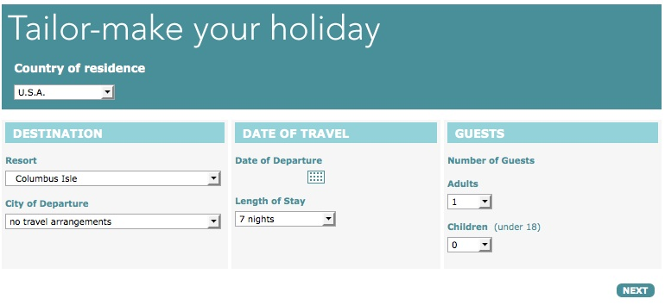
PLACE: CLUBMED.COM
Company Profile
Symptoms
Company Analysis
International Strategy
Advertising Campaign
ABCD Paradigm
Reflections

Slide 19
PLACE: INTERNET WHOLESALERS
Air Canada Vacations
Sell Off Vacations.com
TripCentral.ca
Besttravel.com
Expatriatetravel.com
ETC…!
Company Profile
Symptoms
Company Analysis
International Strategy
Advertising Campaign
ABCD Paradigm
Reflections

Slide 20
PLACE: TRAVEL AGENCIES
Company Profile
Symptoms
Company Analysis
International Strategy
Advertising Campaign
ABCD Paradigm
Reflections

Slide 21
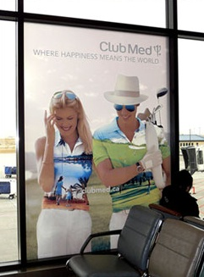
PROMOTION
Airports
Travel Magazines
Billboards
TV ads
Website
Affiliate websites
Club Med Great Members loyalty program
Company Profile
Symptoms
Company Analysis
International Strategy
Advertising Campaign
ABCD Paradigm
Reflections
Notes:
Scheduled for rollout in January 2009, the loyalty program will be introduced worldwide throughout the year. One of more than 200 programs tested, Club Med Great Members ranks in the top 20% in terms of intention to buy, attractiveness and ability to meet customer expectations. Members will be entitled both to special benefits in the villages, which make their vacations even more enjoyable, and to visual signs of recognition.

Slide 22
COMPETITIVE POSITIONING MATRIX
Company Profile
Company Analysis
International Strategy
Advertising Campaign
ABCD Paradigm
Reflections
Notes:
In 1986, most of the all-inclusive competitors had adopted Club Med's style of recreational activities with staff members acting as directors of these organized games. By then, the only major difference that Club Med maintained was the fact that their price did not include drinks. In Jamaica in the late '70s, executives founded the chain that would evolve into SuperClubs. They began by targeting Club Med's weaknesses, rooms too Spartan, the price didn't include liquor, and the fact that some people found activities too regimented and the mealtimes inflexible. So the new resorts offered better rooms, included drinks, and gave guests more flexibility. Soon other all-inclusive were sprouting around the Caribbean. The chain that became Sandals launched in 1981.
Club Med built a healthy business in the '60s and '70s catering to singles. Then it went after families. But it got in trouble with the Baby Boomers, who wanted more luxuries than Club Med offered. Club Med is at risk of being overtaken by competitors more in tune with the market. That includes other all-inclusive resorts and cruise lines, which offer one-price packages with an ever-increasing array of amenities.
By the '80s, vacationers seeking an all-inclusive vacation had a lot of other options. Companies like SuperClubs rolled out resorts that beat Club Med's pricing and better targeted specific slices of the traveling public, like singles, couples, or families. Other firms created more upscale resorts, like the couples-only Sandals chain.
Club Med, on the other hand, suffers from ecological, economical, and political constraints that prevent the firm from using this individual pricing method which could lead to customized packages for vacationers.
Top competitiors:ACCOR Carlson Companies, Inc. Carnival ClubCorp, Inc. Royal Caribbean Cruises Sol Melia S.A. Starwood Hotels & Resorts Worldwide, Inc. TUI AG

Slide 23
SWOT ANALYSIS
Strengths
Established name
Reputation
Customer loyalty
Perception of a place to meet people (match.com)
Weaknesses
Global span means more susceptible to natural disasters
All inclusive formula limits discounting
Perception of swinger’s resorts (bad for attracting family segment)
Company Profile
Company Analysis
International Strategy
Advertising Campaign
ABCD Paradigm
Reflections

Slide 24
SWOT ANALYSIS
Opportunities
Movement into China
Cash injection from Accor has allowed revamp of aging resorts
Attraction of fitness market
Threats
High competition from customized trip providers
Merging of competitors (i.e. Allegro and Jack Tar Village)
Economic crisis impacts heavily on tourism
Company Profile
Company Analysis
International Strategy
Advertising Campaign
ABCD Paradigm
Reflections

Slide 25
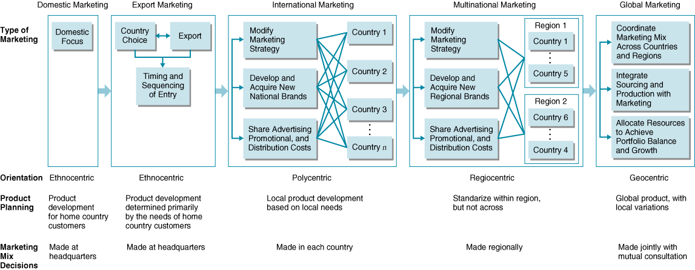
Company Profile
Company Analysis
International Strategy
Advertising Campaign
ABCD Paradigm
Reflections

Slide 26
INTERNATIONAL STRATEGY
❖ Focus sales and marketing efforts on France, US Canada, Belgium, Japan, Italy, Germany and Switzerland [74% of visitors]
❖ No. 1 target is to increase US sales
1998-2004: $350 million has been spent on advertising in the US alone
❖ Pacific Rim expansion, Indonesia, China, Philippines and Vietnam
Company Profile
Company Analysis
International Strategy
Advertising Campaign
ABCD Paradigm
Reflections

Slide 27
INTERNATIONAL STRATEGY
❖ Increase of strategic alliances with firms all over the world
❖ 2004 Accor bought 28.9% stake
❖ 500 million Euro expansion and revamp of resorts
❖ Increasing trend of health holidays addressed by gym facilities and classes
Company Profile
Company Analysis
International Strategy
Advertising Campaign
ABCD Paradigm
Reflections

Slide 28
MARKETING
Imagery to emphasize natural beauty of resorts
Families used to attract traditional segments
Theme of meeting new people expressed through photos of couples
“Its not where you go, its who you meet.”
Strategic alliance with Match.com
Company Profile
Company Analysis
International Strategy
Advertising Campaign
ABCD Paradigm
Reflections

Slide 29
Current ad campaign: WHERE HAPPINESS MEANS THE WORLD
Company Profile
Company Analysis
International Strategy
Advertising Campaign
ABCD Paradigm
Reflections

Slide 30
Current ad campaign
WHERE HAPPINESS MEANS THE WORLD
Company Profile
Company Analysis
International Strategy
Advertising Campaign
ABCD Paradigm
Reflections
Notes:
DENMARK

Slide 31
Current ad campaign
Company Profile
Company Analysis
International Strategy
Advertising Campaign
ABCD Paradigm
Reflections
Notes:
FRANCE

Slide 32
Current ad campaign
WHERE HAPPINESS MEANS THE WORLD
Company Profile
Company Analysis
International Strategy
Advertising Campaign
ABCD Paradigm
Reflections
Notes:
ENGLAND

Slide 33
Current ad campaign
WHERE HAPPINESS MEANS THE WORLD
Company Profile
Company Analysis
International Strategy
Advertising Campaign
ABCD Paradigm
Reflections
Notes:
ENGLAND

Slide 34
ACCESS
❖ Economic
❖ Cost of Flights and Services
❖ Income Distribution of Customers
❖ Physical
❖ Availability of direct flights
❖ Visas
❖ Developed infrastructure
Company Profile
Company Analysis
International Strategy
Advertising Campaign
ABCD Paradigm
Reflections
Notes:
Availability of direct flights
Most of the villages creating by Club Med are easily accessible by international flights. When a location lies outside the flight paths for major airlines, Club Med will go out of its way to provide alternative forms of transportation. Future locations for villages MUST be accessible by aircraft.
Visas
Some countries have strict passport and visa restrictions, most notably Russia. Getting a visa, when required, is the first barrier to entry that must crossed by potential customers?
Developed infrastructure
Many exotic locations are relatively untouched by human civilization. This mean even the most basic of facilities may have to be built from scratch. Tourists from developed areas of the world take for granted the convenience of such things as indoor plumbing, air conditioning, and hot/cold running water. Cooperating with tourism departments in foreign countries to implement strategies in order to boost infrastructure will cater to growing tourism inflows, and will be mutually beneficial.

Slide 35
BUYING BEHAVIOUR
❖ Attitudes towards vacations
❖ Growth in Healthy Tourism
❖ General trend to Working Hard
❖ Need for Relaxation
❖ Cultivate Brand Loyalty
Company Profile
Company Analysis
International Strategy
Advertising Campaign
ABCD Paradigm
Reflections
Notes:
How is the decision to buy made by consumers?

Slide 36
CONSUMPTION CHARACTERISTICS
Decline in Sex Tourism of early generations, move towards family orientated approach
Facilities are now more family friendly
Company Profile
Company Analysis
International Strategy
Advertising Campaign
ABCD Paradigm
Reflections
Notes:
Club Med provides Day Care services, included in their complete package approach

Slide 37
DISPOSAL
❖ Leave No Trace (LNT)
❖ Disappearing Coral Reefs
❖ Warm Up in the Alps
Company Profile
Company Analysis
International Strategy
Advertising Campaign
ABCD Paradigm
Reflections
Notes:
Tourists are encouraged to leave the exotic locations just as they found them.
This is particularly important for Club Med locations in the Caribbean next to coral reefs.
Human interaction with living coral in the Caribbean has resulted in thousands of reefs slowly dying
Coral reefs are the basis for a multibillion-dollar tourism, and are the “goose that lay the golden egg,” propping up small island economies.
Warm Up in the Alps
Global warming has caused glaciers in the alps to retreat.
But since 1850, western Europe's glacial area has shrunk by up to 40%, and the volume by more than 50%.
Longer-term studies suggest that the Alpine glaciers have been retreating for the last 150 years, and some scientists believe they could disappear completely by 2050.

Slide 38
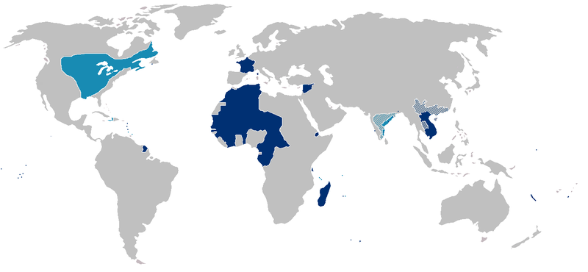
CLUB MED IN THE WORLD
Company Profile
Company Analysis
International Strategy
Advertising Campaign
ABCD Paradigm
Regional Differences

Slide 39
CULTURE
❖ Post Colonial Legacy
Ethnocentrism
Legal Status of Former Colonies
Village Locations in Africa Must Be Aware of the Dangers Posed by…
-Fundamentalism
-Religion
-Terrorism
Company Profile
Company Analysis
International Strategy
Advertising Campaign
ABCD Paradigm
Regional Differences
Notes:
The French company has many of its villages located in countries that were formerly part of the French Empire. Ex. St. Dominique(Haiti), French Indochina (Vietnam, Cambodia, Laos) and French Polynesian (Marquesas Islands, Tahiti, Bora Bora, and Bass Islands), and Africa (Senegal, Tunisia, Morocco)
The French annexed various Polynesian island groups during the 19th century. Africa was colonized about the same time in the Second French Empire. Long history of colonial subjugation and rule.
Ethnocentrism: France unsuccessfully fought bitter wars in the 1950s and early 1960s in Vietnam and Algeria to keep its empire intact. Prescence of historical resentment in many regions of Africa
Legal Stautus is overseas lands of France; overseas territory of France from 1946-2004. For French tourists this means no visa is required, and laws of France still apply. In fact, the contitution of French Polynesia is the same as france, and the chief of state is Nicolas Sarkozy.
Club Med has villages in known hotspots such as Tunisia, Senegal, Morocco, Turkey, Mexico, Brazil, Egypt
EX. Tunisia
Tunisia is among the most vulnerable of the North African countries because its rigid repression of Islamism has created a well of resentment among religious youth, and its popularity as a tourist destination for Europeans makes it an attractive target. (CIA FACTBOOK)
Al-Qaeda is known to have operations in Tunisia, and Tunisia has been mentioned by US Intelligence forces as being a possible hiding place for international terrorist Osama Bin Laden . (CIA COUNTER-TERRRORISM UNIT)
Kidnappings and Ransom of European and American tourists are frequent occurrences across Africa, and pose a serious threat for Club Med expansion in Africa.

Slide 40
EXOGENOUS VARIABLES
❖ Nuclear Testing
❖ Environmental Shocks
❖ Inflation
❖ Regime Change in Unstable Governments
❖ Corporate Taxes
❖ Native v. Foreigner Relations
Company Profile
Company Analysis
International Strategy
Advertising Campaign
ABCD Paradigm
Regional Differences
Notes:
In September 1995, France stirred up widespread protests by resuming nuclear testing on the Mururoa atoll after a three-year moratorium. The tests were suspended in January 1996. In recent years, French Polynesia's autonomy has been considerably expanded. (CIA FACTBOOK)
Vulnerable to exogenous shocks from the environments, tsunamis, hurricanes, floods
Authoritarian regimes and unstable currency fluctuations. For example the first Cancun village in Mexico had to be shut down after assurances for financial assistance by the Mexican government went unheeded, and inflation of the peso resulted in huge operation expenses for club med.

Slide 41
THE FUTURE
China
India
Mexico
Company Profile
Company Analysis
International Strategy
Advertising Campaign
ABCD Paradigm
Regional Differences
Notes:
Lastly, Club Med is pursuing development programs in new growth markets, notably China, which has considerable potential for upmarket customers; Mexico, a country where Club Med is being repositioned upmarket; and India, where a sales office was recently opene

Slide 42
REFERENCES
http://www.clubmed.com
http://news.bbc.co.uk/1/hi/sci/tech/1507646.stm
http://www.coral.org
http://www.iht.com/articles/2007/02/20/news/tunisia.php?page=3
https://www.cia.gov/library/publications/the-world-factbook
Company Profile
Company Analysis
International Strategy
Advertising Campaign
ABCD Paradigm
Regional Differences

Slide 43
QUESTIONS?

